Slide 1
Project Management
Kevin Wieser and Nicole Leung
Day 2
July 6, 2021
STS IFHOHYP COE

Slide 2
Project management typically involves:
•A short-term project
•A specific outcome
•Resources – human and capital

Slide 3
Charting your path
Vision
What do you envision?
Project planning
What will the process of reaching that goal involve?
Ideas
What are the recommendations to reach that vision?
Imagine
What does that vision look like in your surroundings?
Notes:
Sketch your idea. Take a moment to envision your goal.
Okay you’ve got your own. Take some time to look around and observe your surroundings.
Imagine what that goal would look like in your surroundings.
This is where a solution to your community needs may arise. Perhaps you need to conduct a needs assessment first and that is a project within itself. Or perhaps you have conducted your needs assessment and now need to apply a way to make those recommendations come to life. What does this process look like? You may need to create a project plan.

Slide 4
Project Management
Define the goal
Design
Implement
Evaluate
This drives the project,
Map out the time, steps, resources.
Follow your Plan
Notes:
Planning uses the goal to define, design, build process to implement
1.Define goal/outcome: The outcome/goal(s)
typically predetermined, and initiates and drives the project.
2. Plan: is the most important step in the process – and most complicated. Planning involves assessing 3 key elements:
–Time
–Steps
- resources
3.Implement
4.Evaluate

Slide 5
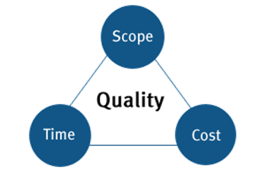
Design the Project
Resources
people, equipment, facilities, funding, online tools, services, information etc required for the completion of a project activity.
Resources
Time
Steps
deadline, milestones, allocation of work between team members and business as usual.
Steps
the defined features and functions of a product, or the scope of work needed to finish a project -- deliverables, tasks, costs, phases of the project.
Notes:
Typical conversion of goal from design to execution can be 8-12 months but depends on the project!

Slide 6
Designing the Team
Project Manager
Teams & Team Leaders
Overlooks the tasks to ensure meeting the goal, communicates with everyone, modifies project if needed
Contribute to overall project objectives
Complete individual deliverables
Design
Stakeholders
Mentors
process deliverables, and provide subject matter expertise. Sometimes are customer representatives
Provide expertise & support to project manager.

Slide 7
Implementation
Strategy
Documentation
methods of going about tasks, problems and teamwork.
process of recording the key project details and producing the documents that are required to implement it successfully, many forms
Actually doin’ it!
Milestones
Adjustments
are used as signal posts for a project's start or end date, a reference point that marks a significant event or a branching decision point
bring the activities that are behind into alignment so that the execution of the project runs smoothly
Resource allocation
Communication
Scheduling is a plan that you develop with the aim of making the most of the available resources at your disposal
keeps conflict and removes confusion, ensuring team is aligned with project goals and know exactly what's expected of them, builds team-wide trust

Slide 8
Evaluation
Result
Process
Evaluation
Lessons learned
Budget

Slide 9
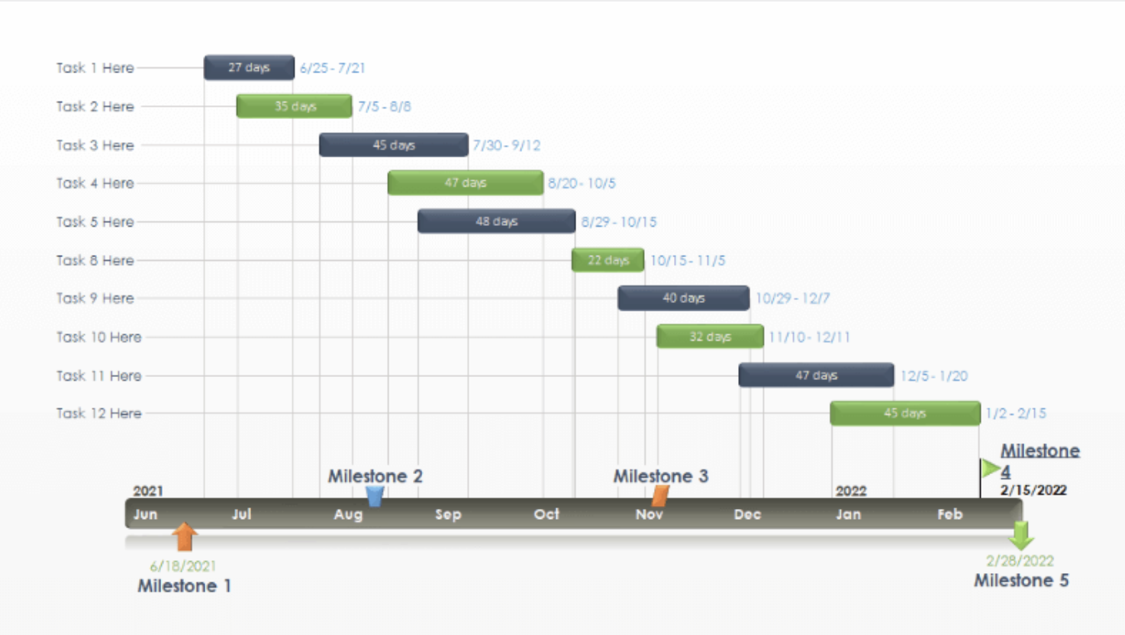

Slide 10
Case study example:
Example:
After you conduct a community needs assessment, you discover there is a recommendation for education about leadership training for hard of hearing people.
You want others to be successful in their community projects and you want to help them by providing an educational online workshop.
How do you do this?
Notes:
See Miro Board for what Participants have shared.

