Slide 1
Setting Goals: the SMART way
IFHOHYP Study Session 2021
Created and Presented by
Nicole Leung and Kevin Weiser

Slide 2
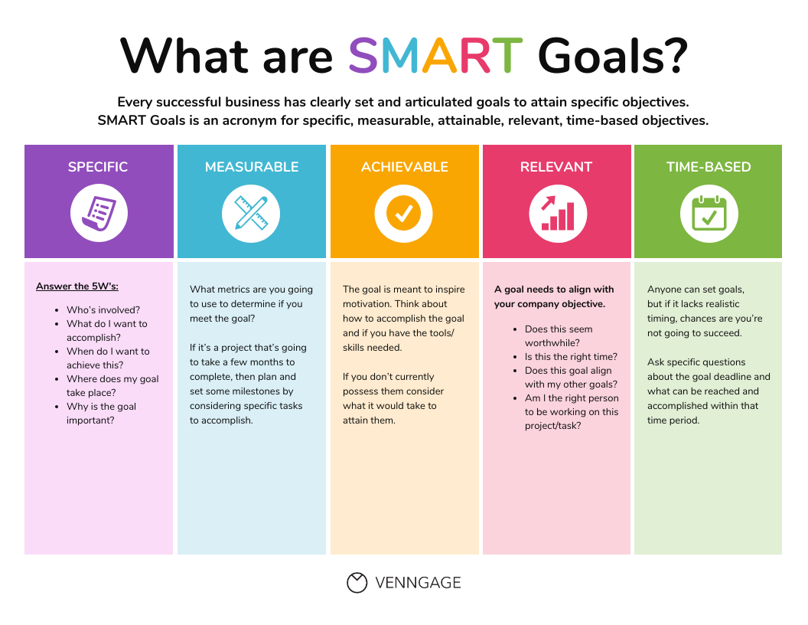

Slide 3
Example - We want to grow our organization
Specific: We will acquire five new member for our organization.
Measurable: We will measure our progress by how many new member we bring on while maintaining our current member base.
Achievable: We will ask current members for referrals, launch a social media marketing campaign and network with local organizations.
Relevant: Adding additional members to our organization will allow us to grow our organization and increase our visibility.
Time-bound: We will have five new members within one month.
Notes:
Move to the Miro board. Participants will take their community needs analysis and start writing a plan for their advocacy project by creating a SMART goal. Discussions will follow about how SMART goal settings are not always the best method of creating goals when it comes to social change projects.

