Slide 1
A Social Media Campaign

Slide 2
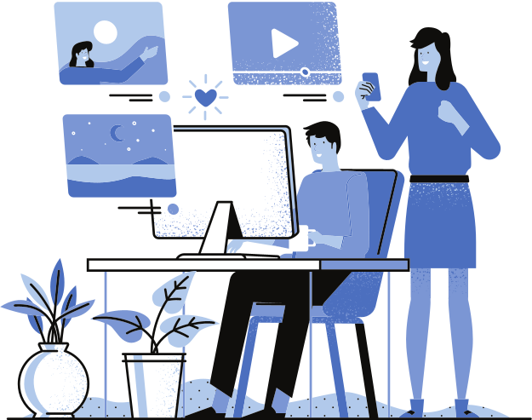
What is that?
A social media campaign is a coordinated marketing effort to reach a business goal using one or more social media platforms.
*It's not the same as everyday social media efforts because they have more increased focus, they are more concentrated on target group and measured with different factors.​

Slide 3
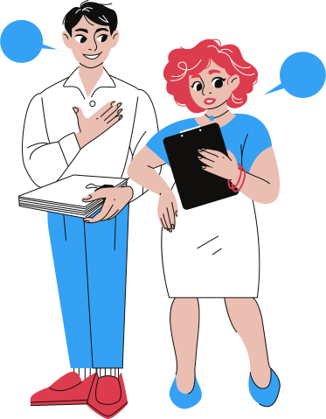
Examples?

Slide 4
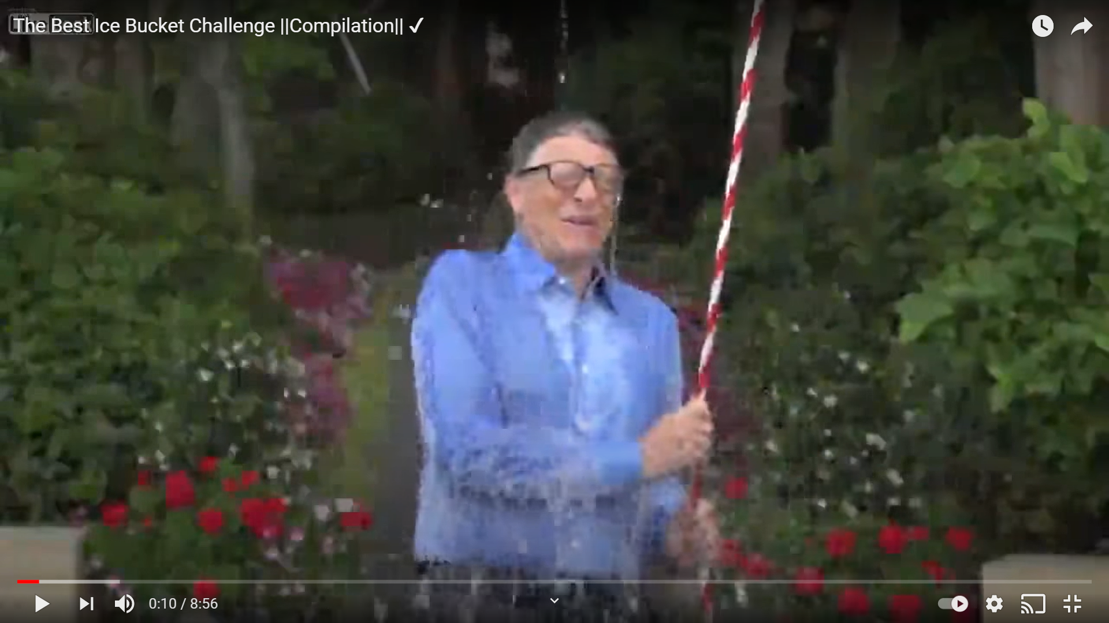
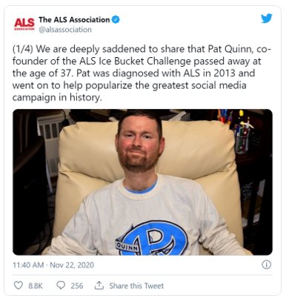
https://youtu.be/9Nk7Voi0duQ?t=310
Notes:
Nicole: (Clicks link of video) Play until 06:13
I don’t know if you're familiar with the ALS Ice Bucket Challenge, but it was a big trend in 2014 where people used Social Media to raise money and awareness for ALS, amyotrophic lateral sclerosis by sharing videos of themselves having ice-water thrown on themselves and nominating others to do the same and to donate to ALS.
It went on to raise $115 million in donations.
But do you know the story behind it? It was started by Pat Quinn who later died at 37 years old. And the Ice Bucket challenge has been around since the 80s and also has origins in Norway despite this taking off in the States. So why was this a big hit? And did it really do what it was intended to do? Look at how social media was used. It was sharing videos on Facebook mostly and tagging people. But how about donating money? You had to either find the link yourself unless it was shared with the video. And did it really teach people about ALS? You had to go google that yourself if you were really interested. But in the end, it was a pretty big success.

Slide 5
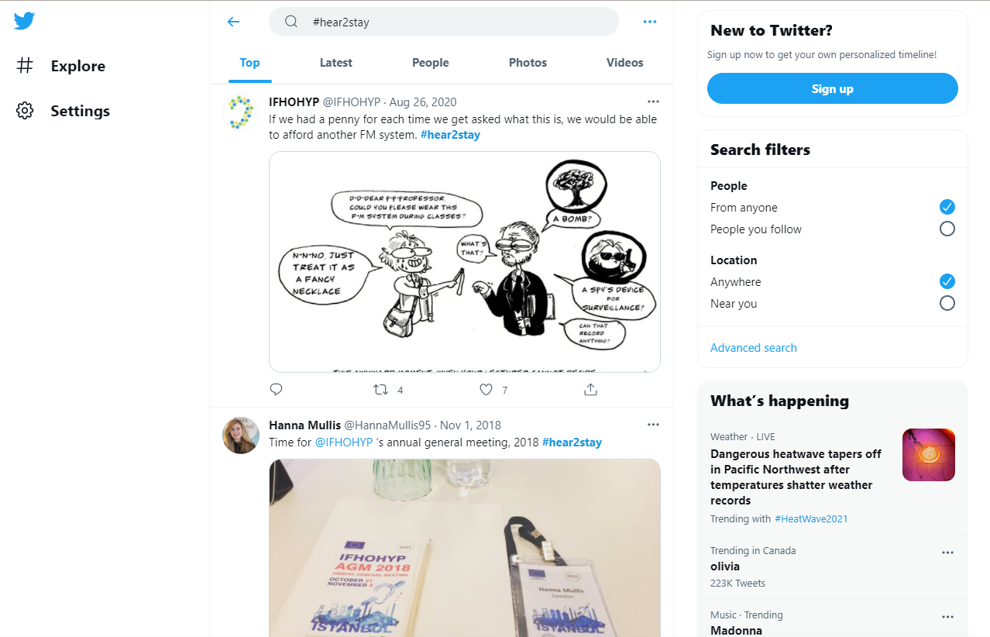
https://twitter.com/hashtag/hear2stay?lang=en
https://www.instagram.com/explore/tags/hear2stay/
Notes:
Nicole: Does anyone know this Hear2Stay Campaign?
You'll notice the IFHOHYP posted about it. Do we know what it was about and how this campaign works? (pause). It's an awareness raising campaign, started in 2017 Budapest during another study session, and is open to everyone to use it to share their voice about the same issue.
This is shared on Twitter and you can see it's the Top posts from 2020 and 2018, not very recent, but if you go to Instagram [open link: https://www.instagram.com/explore/tags/hear2stay/ ])
You can see people who purposely used the tag. [see some examples –Tomasz, Tatia, some other organizations] and it's a fun way to stay connected.
Stepping back: is this successful? Is it doing what it needs to do? What was its goal? It really depends on the campaign's goals; some have a monetary goal

Slide 6
How to plan YOUR social media campaign?

Slide 7
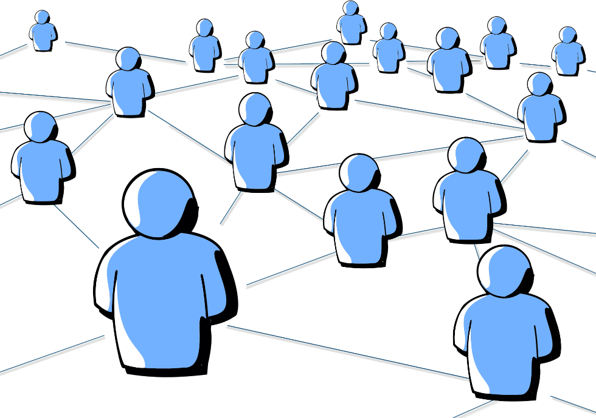
DEFINE YOUR GOALS
1
I want to make as many people (>2k) as possible aware about the existence​ of my brand!
4
I need to encourage audience to get more customers = bigger awareness/more money​
2
I need to develop my 'business' contacts, create a web of people (government representatives, 3 companies, teachers, influencers)
I want to involve people, to create a great community around my campaign
5
3
I want to become a millionaire or help people - get some money for this! (Minimum 300,000$)

Slide 8
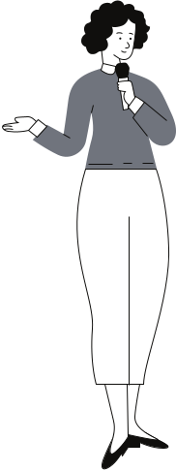
1
Who is your target audience?
2
What factors should be taken into consideration?
KNOW YOUR AUDIENCE
If you know your audience, it'll guide help your social media content!
Notes:
Nicole: Planning your social media campaign should also really think about your audience from their point of view.
Who is your target audience? Do you want to hit up young people to help start a conversation?
What factors should you take into consideration when it comes to Knowing Your Audience?
Once you know your audience, it can really help guide your social media content and campaigning.

Slide 9
Who would identify with your initiative?
When they see your social media campaign, what actions are they most likely to do?
Cultural relevance
Their Pain points
Channels & Avenues (theirs and yours)

Slide 10
Choose your social media platform

Slide 11
Video dimensions
Twitter Video Dimensions
LinkedIn Video Dimensions
Facebook Video Dimensions
Instagram Video Dimensions
YouTube Video Dimensions
Pinterest Video Dimensions
TikTok Video Dimensions
Landscape video recommended dimensions: 320 x 180, 640 x 360 and 1280 x 720
Portrait video recommended dimensions: 240 x 240, 480 x 480 and 640 x 640.
Video length: max 140 sec | max 512 MB
Average video length: 45 sec
Video ad recommended dimensions: 1200 x 1200
Video ad length: 140 sec | max 1 GB
Required video dimensions: 480 x 360, 640 x 360, 640 x 480, 960 x 720, 1280 x 720, 1440 x 1080, 1920 x 1080
Video length: max 10 min
Average video length: 30 min
Ad video dimensions: 1440 x 1080, 1920 x 1080
Ad video length: 30 min | max 200 MB
Cover video length: 20 sec - 90 sec
Cover video dimension: 820 x 312
Shared video dimension: 1280 x 720 | max 4 GB
Min video width: 600 pixels
Video length: max 120 min
Average video length: 1 min
Ad video: at least 1280 x 720 | max 4 GB
Ad video length: max 240 min
Facebook video story: 1080 x 1920
Min video resolution: 600 x 315, 600 x 600, 600 x 750 | max 4 GB
Video length: max 60 sec
Average video length: 30 sec
Stories resolution: 1080 x 1920 (min 600 x 1067) | max 4 GB
Stories length: max 15 sec
IGTV video resolution: 1080 x 1920
IGTV video length: max 10 min, 60 min for verified accounts
Recommended video dimensions: 854 x 480, 1280 x 720, 1920 x 1080, 2560 x 1440
Min video dimension: 426 x 240.
Max video dimension: 3840 x 2160.
Video length for unverified channels: max 15 min
Video length for verifies channels: max 12 h
Max video size: 128 GB
Average video length: 2 min
Recommended video dimensions: 600 x 600, 600 x 900
Max video length: 30 min
Max file size: 2 GB
Recommended video dimensions: 1080 x 1920
Video length: max 15 sec, can combine segments up to 60 sec | max 287.6 MB (iOS), 72 MB (Android)
In-feed ad video resolutions: 720 x 1280, 640 x 640, 1280 x 720
Ad video length: 5 - 16 sec | max 500 MB
https://www.renderforest.com/blog/video-dimensions-social-media

Slide 12
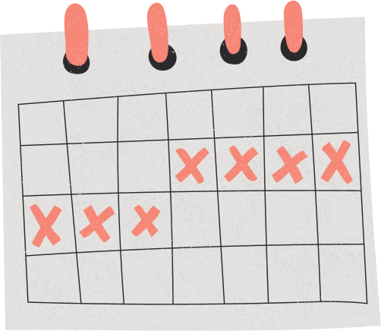
Create posting agenda
Define how often and how regularly are you gonna post, according to the platform you'll use and the hour that it might have best reach out

Slide 13
DON'T FORGET ABOUT SOME VISUAL CONTENT!
No one wants to read a wall of text, especially when we're flooded with information from everywhere. Use e.g. Canva or look for graphic designer!

Slide 14
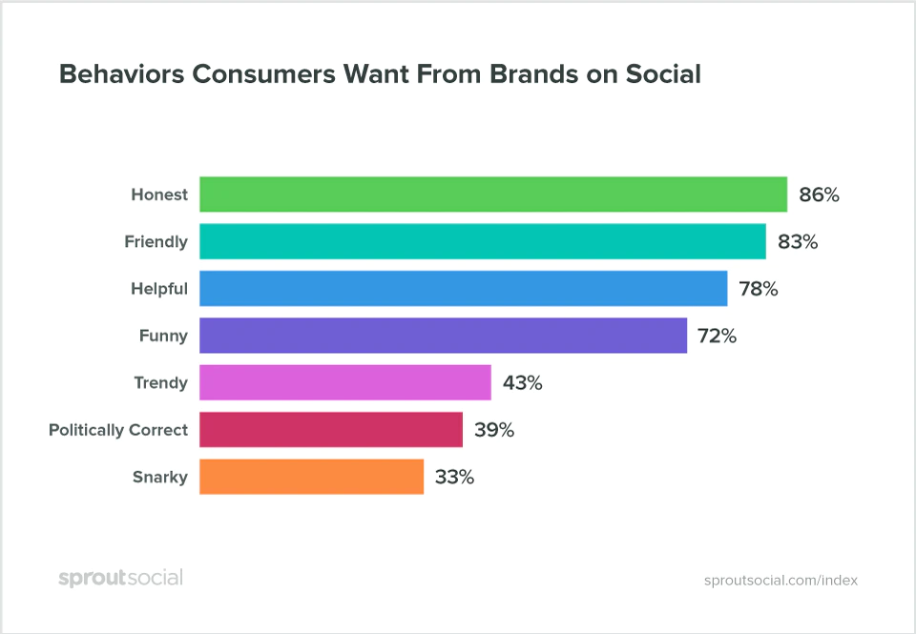
POST IT!
And analyze it afterwards to see what can be adjusted. ​
​
Listen to your audience​

