Slide 1
Community Needs Assessment
July 6, 2021
Day 2
STS IFHOHYP COE
Presented and created by Nicole Leung & Kevin Weiser.

Slide 2
What is the importance of a community needs assessment to everyone here?

Slide 3
Overview
Community Needs Assessment involves gathering data and input on what the community needs. Assessment also provides a way for the community’s voice to be heard. Change strategies must reflect the needs of the community to have the intended impact.
A systematic process for summarizing the needs and assets in a community specifically for the purpose of taking action to improve it.
When assessments provide clear community and data driven recommendations to legislators, program designers and other decision-makers, they facilitate informed actions… the process can also strengthen relationships, deepens understanding, raise awareness of needs, assets, challenges, successes, and increase the sense of ownership & investment that individuals feel in a community.
Notes:
Source: CDC https://www.cdc.gov/nccdphp/dnpao/state-local-programs/change-tool/community-change-process.html

Slide 4
“Not just a matter of surveying what people need, but it is a community organizing strategy. By rigorously and creatively assessing community needs, the process gives real ‘voice’ to individuals in the community…voices that can significantly influence program design.” --Chang, 1994
Notes:
Source:
Public Health Nutrition: Essentials for Practitioners; Community Health Assessment: Key Tools of Public Health Nutrition page 56-57. https://books.google.ca/books?id=P7PsDwAAQBAJ&pg=PA57&lpg=PA57&dq=%E2%80%9CNot+just+a+matter+of+surveying+what+people+need,+but+it+is+a+community+organizing+strategy.+By+rigorously+and+creatively+assessing+community+needs,+the+process+gives+real+%E2%80%98voice%E2%80%99+to+individuals+in+the+community%E2%80%A6voices+that+can+significantly+influence+program+design.%E2%80%9D+--Chang,+1994&source=bl&ots=OfWrNUsZQh&sig=ACfU3U2Z2MfRLxQb7JBZq5qM2-QNB3sr2Q&hl=en&sa=X&ved=2ahUKEwjluM3nsrrxAhWF4J4KHVhXBscQ6AEwAHoECAIQAw#v=onepage&q=%E2%80%9CNot%20just%20a%20matter%20of%20surveying%20what%20people%20need%2C%20but%20it%20is%20a%20community%20organizing%20strategy.%20By%20rigorously%20and%20creatively%20assessing%20community%20needs%2C%20the%20process%20gives%20real%20%E2%80%98voice%E2%80%99%20to%20individuals%20in%20the%20community%E2%80%A6voices%20that%20can%20significantly%20influence%20program%20design.%E2%80%9D%20--Chang%2C%201994&f=false

Slide 5
The Process
The Community
The Assessment
Analysis
Recommendations
What is the community here?
Who should be part of the team?
Networking
Ethics
Conflict of interest
Plan + organize
Purpose
Scope
Questions
Timeline
Methods
Data collection strategy?
Qualitative vs Qauntitative
Interpret!
Actionable plan
Disseminate data.
Timeframes for re-measuring data for changes.
Notes:
Come to understand the process because there are important elements to consider.
Think about the Who: The community: understand who the community is (who they consist of) and partner with that community. Your greatest assets are just people, from students to governors. To get started, you should gather your contacts and reach out to community leaders.
You want to be purposeful in your assessment because people might ask you what the research is for.
Does your organization address gaps in community health? In education? You may want to address homelessness and its many causes, or you may focus your resources on a smaller group that is disproportionately affected by a gap in services.
It can be tempting to want to assess and address all the needs in your community. But by identifying community needs based on your available expertise and resources and narrowing your scope accordingly, you can better concentrate your efforts on what will achieve the most impact. That’s why it’s important to define the intended reach or scope of your program from the outset.
Your scope should largely depend on the resources available in your community. While it’s helpful to set lofty goals, it’s also important to know your scope and set achievable goals—and seek growth as your program becomes more established.Your data will include statistics, but the numbers aren’t enough, especially when you’re dealing with real people who have real needs that go beyond what is quantitative. You should also collect qualitative data, like the thoughts and knowledge of community members.
Analyzing and Data-driven recommendations. Sometimes in your assessment you will find recommendations already made and sometimes you will create recommendations. This is where idea generating and brainstorming involves talking to others and really understanding your community to know if the solution is one that is affordable and obtainable.
Sources: https://www.galaxydigital.com/blog/community-needs-assessment/#steps

Slide 6
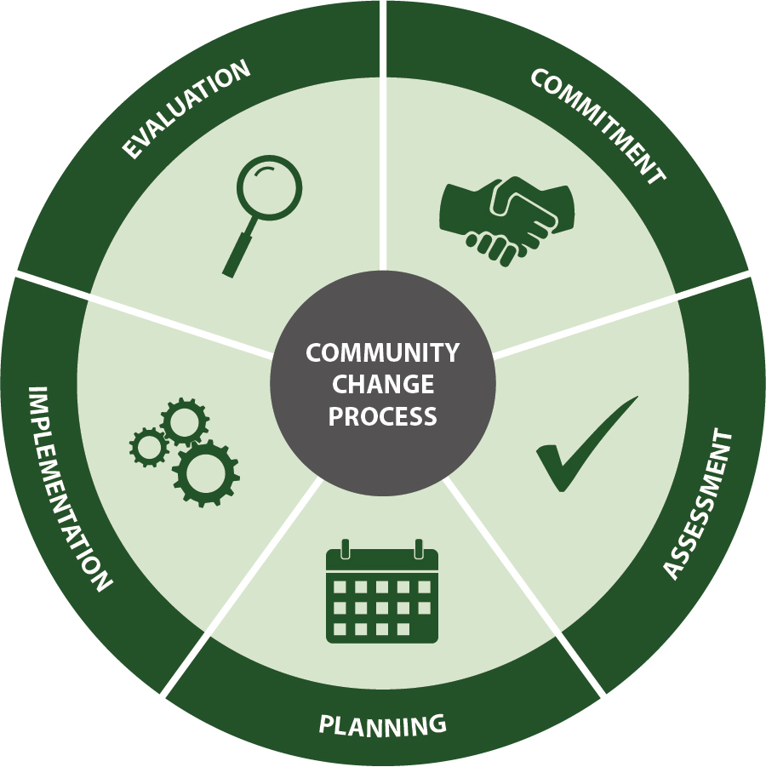
Assessment
objectives:

Slide 7
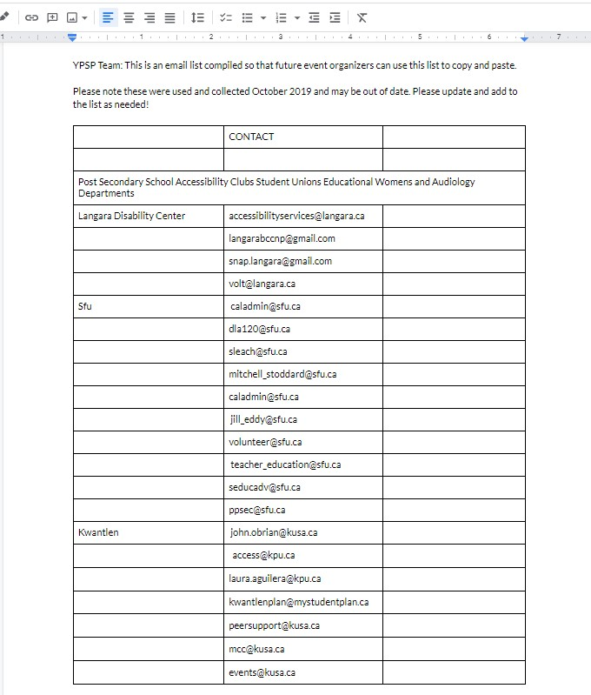
Example
Notes:
Find what that voice is saying
Actionable recommendations.

Slide 8
We measure what we value
and we value what we measure

Slide 9
What are the tools for community assessments?
Notes:
Overview of different forms of surveying
Observation
Photography
Focus groups
Interviews
Secondary data collection
Questionnaires

Slide 10
What is involved in each method?
Provide an example
Notes:
See the Miro board for answers!

