Slide 1
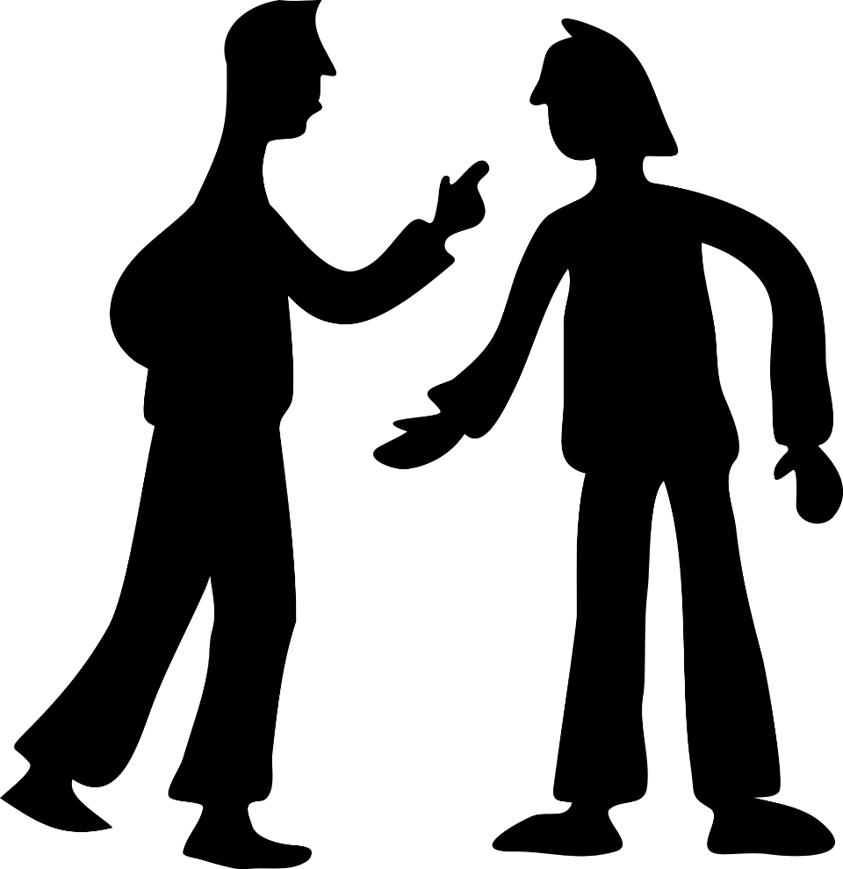
CONFLICT
MANAGEMENT
(HOW TO NOT KILL EACH OTHER)
IFHOHYP Study Session 2021
Presented and Created by Maria Skoczyńska and Nicole Leung

Slide 2
YOU CANNOT PLEASE EVERYONE - DO NOT MAKE PROMISES YOU CANNOT KEEP
THINK BEFORE REACTING - KILLING SOMEONE DOESN'T SOLVE CONFLICT ;)
PRINCIPLES:
EXAMPLES
CALMNESS
TRY TO UNDERSTAND OTHER PERSPECTIVES
(EMPATHY CAN BE BENEFICIAL)
EMPATHY
LOOK FOR COMPROMISE
ASSURE FAIR PROCESS
TAKE RESPONSIBILITY IF YOU MADE A MISTAKE
FAIR PLAY
Notes:
Strategies to use:
Say This: That sounds really tough. That’s frustrating/scary/sad. There has been so much to worry about. We’ve all been navigating so much uncertainty. I can tell how hard you’ve all worked. Thank you for sharing.
Not to say:That You shouldn’t feel that way. We’ll get over it. You should think more positively. You can’t think like that. You should think more positively. Unsolicited advice. (e.g. Have you tried…?)

Slide 3
HOW TO SOLVE CONFLICT: STRATEGIES
01
03
LIST POSSIBLE OUTCOMES
DESCRIBE A CONFLICT (EXAMPLES CAN BE GIVEN)
02
LIST STRATEGIES ON HOW IT CAN BE ADDRESSED
15 MINUTES
THEN WE REVIEW

Slide 4
HOW TO SOLVE CONFLICT: STRATEGIES
01
03
TURNING DOWN REQUEST FROM TEAMMATE: NOT PLEASING EVERYBODY
ENDING GOSSIP
02
TURNING DOWN REQUEST FROM PUBLIC: NOT PLEASING EVERYBODY
4-5
DISAGREEMENT BETWEEN TEAM MEMBERS (2 GROUPS)
Notes:
01: Strategies:
Encourage positive feedback
Never rant to someone on your team
Don't feed the beast –don’t give them reactions
Assume good intent, give the person a good start/introduction
Address it in private
Okay to get a 3rd person involved as a mediator or witness or unbiaed neutral person
02: example a parent thinks you should make all children be oral and that you should focus on ensuring that the education focuses on speech therapy so they don’t sound "deaf."
03: your teammate wants to spend the donations on social media not on in person events to recruit members, and is passionate about this idea.
04: When a fellow leader in your group doesn't complete their tasks but is also a friend of yours --how do you ask them to do the work? The fellow leader is more laid back but is a nice person.
05: A fellow community advocate is VERY active (almost dictator in style) about sharing their story at any public forum they find, and it does not allow you time to share your community initiative since you both want to advocate for community needs. Their focus is quite different from yours as well as their leadership and working style.

