Slide 1
Sponsors and Stakeholder
IFHOHYP STS 2021
Presented by Kevin Weiser.

Slide 2
What are stakeholders?
Anyone who will be affected by the outcome of the project
Project Manager identifies all stakeholders and manages their expectations
There can be negative stakeholders who are negatively impacted by the outcome of the project

Slide 3
What are sponsors?
Sponsor is also a stakeholder
Sponsor for the project pays for the project

Slide 4
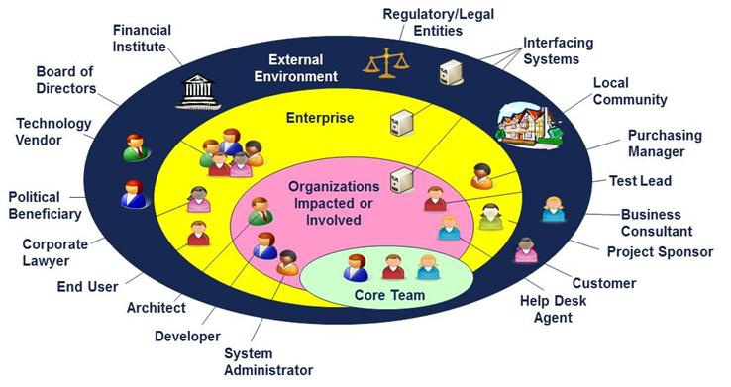
https://www.quora.com/Whats-the-difference-between-a-sponsor-and-a-stakeholder

Slide 5
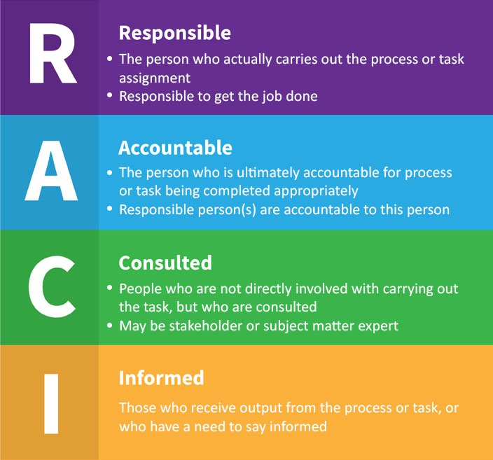
https://www.quora.com/Whats-the-difference-between-a-sponsor-and-a-stakeholder

Slide 6
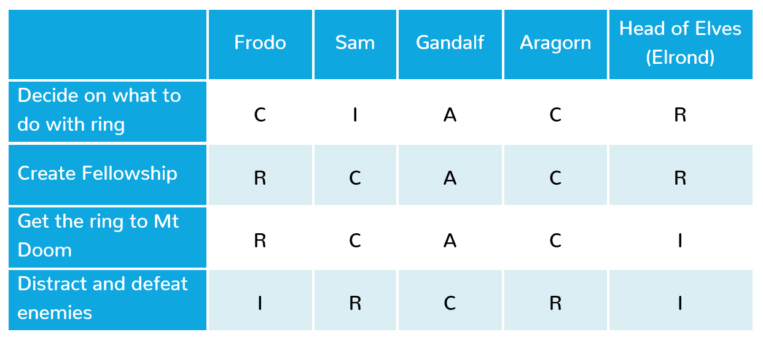
https://www.quora.com/Whats-the-difference-between-a-sponsor-and-a-stakeholder

