Slide 1
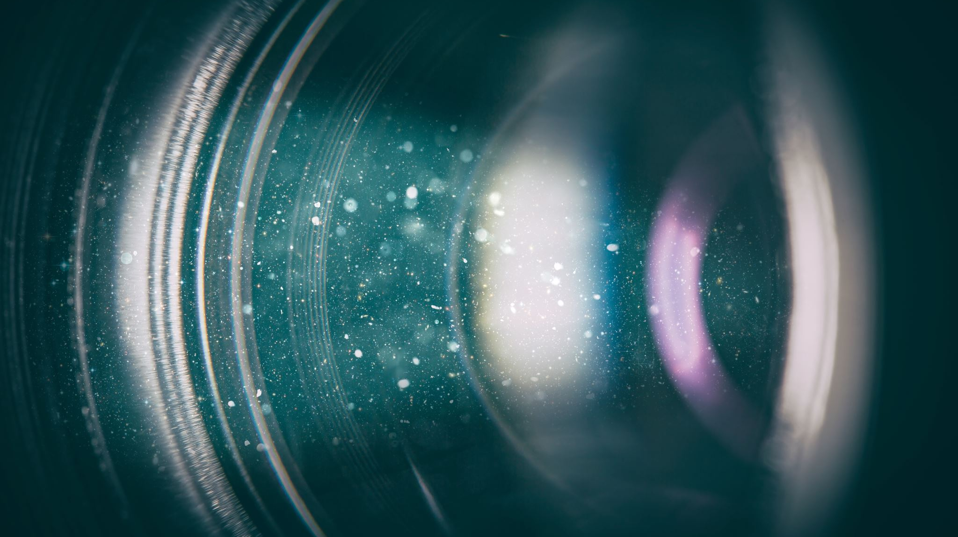
Video editing workshop

Slide 2
About me
Studies: Comparative government law (Constitutions, human rights)
Work: Consultant
Data protection law
IT-support for small business and consumers
Political lobbying for a non-profit (25 %)
Voluntary work
Board member in the International Federation of Hard of Hearing Young People (IFHOHYP)
“Country reporter” summarizing court cases for the digital rights org “noyb”

Slide 3
How to avoid legal trouble
Can you take pictures from the internet?
Copyright
Personal Data
How to portray models
Notes:
So you already know the topic you want to create a video on. You go to Google and search for videos and images. You find some really nice ones. But there's no clear information about what license that image has. Can you use it? What do you think about it?
Exactly there are things you have to consider: Like Copyright, Personal data and you use photos with real people that you have bought from a database

Slide 4
Copyright
Digital ownership to creative work
I can decide
If others must pay for my content
If others can spread, it
Which situation it can be used in (forbid a Nazi organization from using my song)
Copyright Matters
Your song can be taken down or censored
Can be legally liable
Use professional libraries
Notes:
So what is copyright? Copyright is about ownership of something that has been created through a creative process. You can have copyright over a book you wrote, a photograph you took, or a video you created.
The owner of a copyright can decides whether other people can copy or use their work, and they can also decide that others must pay to use their work.
Think of it like owning a house. You decide who can enter your house and the like. But in this case, it is about you being able to decide whether something you have produced can be used by others.
In Europe and the United States, copyright is seen as very important to a functioning digital economy. Since everything is digital and it's technically easy to copy things. If I could take a video that Maria produced and worked on for six months and sell it to make money, she wouldn't be able to make a living from it.
And the same goes for companies that make software or music. But it's also true for newspapers. The way to make sure that newspapers can be independent of the government is to allow them to keep copyright on the articles they write. So people are forced to be subscribers to the newspapers so they can pay their journalists. So in that sense, there's also a link between copyright and free speech.
If you simply copy someone's work in your video without owning the copyright, I don't think they will even pursue you with their lawyers. But there is a high chance that your content will be taken down or censored by YouTube.
Even if you live in a country where copyright doesn't matter much, all the big tech companies like Facebook, YouTube, etc. are American companies. And YouTube in particular automatically scans all uploaded videos for copyrighted material.
And if you have invested a lot of time in creating a video for your org. The last thing you want is for your video to either be taken down. Or for the music track to be muted.
So what do you do? You make sure to only use video, pictures and music which you have a license for.
So what do you do? You make sure you only use videos, images and music that you have a license for.
Actually, you should assume that you can't use this image or video. Copyright law in Europe and the United States automatically gives copyright to the person who created the work. This is only broken by explicit permission from them to use the work. And you may have to wait for them to contact you with permission to use the image.
That's not an effective way to use your time. So one thing that I learned very quickly in creating videos is that you need to have access to stock footage and videos that have been shot by others. And that you have the license to use it.
Now there are databases where you can find free material. You can start there, but I quickly realized that I couldn't find the things I needed to tell a good story.

Slide 5
Where to get Stock media?
Free
Pixabay
Unsplash
Paid
Storyblocks
Shutterstock
Envato Elements
Notes:
I solved this problem by getting access to databases of paid footage. Fortunately, Moovly has access to a very good stock footage library they call Storyblocks. I also pay about $ 150 a year to have access to another library called Envato elements.
Since I have an individual account with envato elements, I can download a license file along with the copyrighted elements I download. Whenever YouTube flags my content as copyrighted, I can send them the proof of license and my video will be shared.

Slide 6
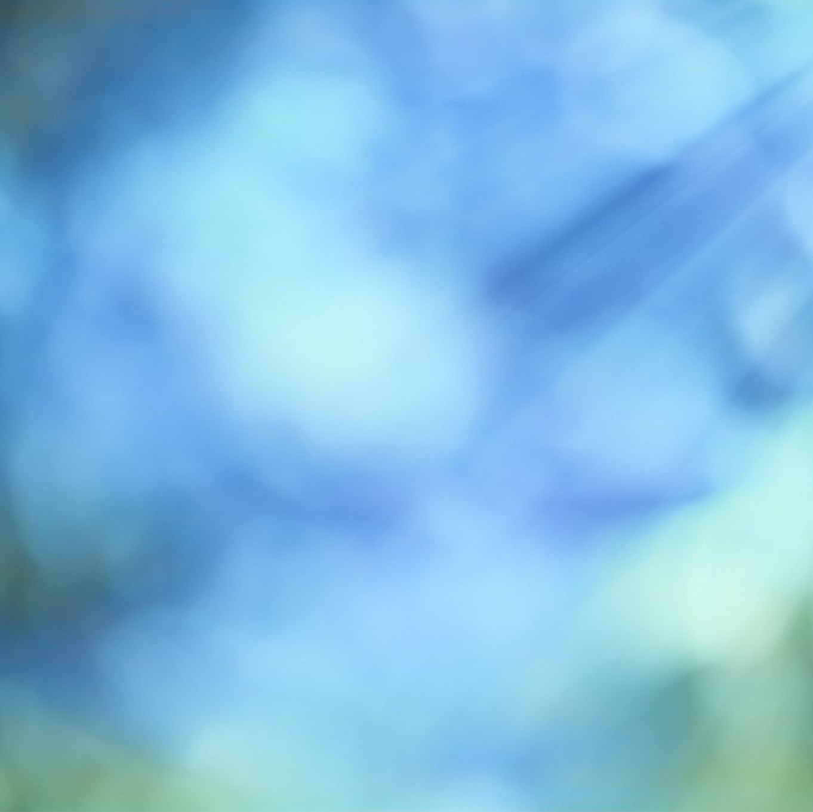
Different types of licenses
In Stock libraries
Editorial use
Commercial use
Creative common
Notes:
One thing to look for when using these libraries is if the video or image comes with conditions. Sometimes it says that a video or image is released for editorial use only. In this case, you are allowed to use it to spread knowledge or news, for example, if you have a video that explains a problem. In these cases, you are not allowed to use it to promote a product or service for example, you are not allowed to use it for commercial purposes. In some cases, creating a video to build your organization's brand could be considered commercial. I know it sounds silly, but I've seen it happen too many times where non-profit organizations are treated the same as commercial businesses. So you need to be mindful of this.
Editorial usage means thinking like a newspaper. It can only be used to spread knowledge or news. Not to promote a product.
On the other hand, if it says it's fine to use it for commercial use periods, then that's the most generous license and you really don't have to worry too much about it.
And then sometimes there's something called Creative Commons which is also good to know. If I create a video about hearing aids. I could say that anyone who wants to can copy my work and use it. But they have to mention my name and make all the changes they made to it public and free for everyone to see. There are different kinds of Creative Commons, but this is just one version of it.

Slide 7
Personal data and Models
Ask the persons in the video / photo for permission.
Exception: Crowds where they are not in focus
Models
Don’t portray them as hard of hearing
Do use a picture of a group of young people in your video
Don’t present them in an offensive way
To promote alcohol, sex toys etc.
Notes:
Another point to think about when making a video is that other people have a right to privacy. now we all come from different countries that have different privacy laws.
I think Europe has maybe the strictest privacy laws in the world. But I will try to be very general.
To avoid trouble, you should definitely ask permission from the people who are featured in any video you create.
This doesn't mean that if you take a camera and film a large Market Square, you have to ask every tourist who happens to appear in the frame if you have their permission. It's more about when a specific person is the focus of your photo or video.
It also depends on the context in which the video will be used. If you record a meeting with your hard of hearing organization and put it on YouTube without permission, they may be upset with you. Especially if you didn't tell them beforehand. If we look at a European context, it is actually the case that the information that someone is hard of hearing is considered sensitive personal information.
These rules are closely related to anti-discrimination law. In Europe, it is illegal to discriminate against people on the basis of disability, religion, ethnicity, gender, etc. And the Data Protection laws of Europe says, for example, that if our organization wants to publish a video online showing that they have taken part in an activity with our organization, we have to ask that person for permission. Because this is indirect information about the persons disability. So it doesn’t even have to be direct information about disability it is also indirect information. It would not be so strict if we were a Tennis Association
So let's say you went to one of those stock footage databases and found a really good picture. But there's a face of a person there. You have a license to use it, but can you do whatever you want with it?
The answer is no. Even if it wouldn't be an illegal issue in your country, in most cases it's a violation of the contracts you have with the database. You always have to be careful when dealing with images or photos that use names or photos that make someone identifiable. You may not know the person in this video personally, but when you post things on the internet, you never know. Maybe the video will reach someone who konws this model.
So the basic rule is, even if you paid for it, be very respectful of other people's names and faces. What does that mean in practice?
It means that if you're hosting a summer camp and you're doing a commercial for it. Then it's perfectly fine to use stock videos of a group of teenagers just having fun.
But it wouldn't OK, make a video of someone standing in front of the camera and smiling. And to say that this is Juan who is hard of hearing.
You shouldn't make statements that imply that a model has a certain disability or political opinion, and you should also be very careful when it comes to sensitive products. so don't make a video that says this person bought a sex toy or alcohol or something, which are offensive times.

Slide 8
Work process
Concept idea
Script
Storyboard
Voice over / music
Video
Notes:
So, now I will tell you about my working process. It's important for me to tell you that I don't have much experience with recording. I've mainly done animation or edited videos. So this working process is tailored to creating an animation or a script.
First of all, you start by getting a clear picture of the message you want to send out. You need to know what the subject of your video is going to be so you have a message
Then you can write a script. At least that's the most effective way. Your instincts will tell you to do everything in the editing program first... and see what happens. I learned the hard way that this is very inefficient. And why?
Because I spent a lot of time trying to make scene 1 and 2 look good. And then when I did scene 3, I realized that this one was supposed to be scene 1. And that caused a lot of extra work because now I had to rearrange everything.
Soundtracks and scene transitions. Especially in an animation program, this is even worse than in a video editing program. So it's better to have a plan for how you want to arrange things, and then do it in the right program.
In the script, you write down everything that's going to happen. Unless it's a recorded video interview. I'm talking about a video that is meant to convey a message that you want.
In the script, you will write each scene. The dialog when the people in the video say something. You will also write the action that happens, for example, if you have a dog running through the scene in the background periods.
Step 3 is what is called storyboarding. You can visually plan out your scenes by either making quick sketches by hand to see what you're going to do. Or you can actually use the video editing software to create a scene with its still image. You don't have to fix the timing or transitions or anything like that. Just take a screenshot for yourself so you can see what the scene will look like.
In the storyboard you have your script along with snapshots of the scenes.
Step 4 would be to look at the audio. If you want to use music, look for music that fits the mood of the message. there are ways to find music that fits the feeling you want to evoke.
You're trying to find music that fits the feeling. And if you have your own pre-recorded videos and images that you know you want to use, then you would try to find music that fits the images. but if you're using stock footage, you usually find the audio first. And then you can find images to go with it
If you have a voice actor, I think it's also important that you do at least a preliminary voice recording yourself.
So why is it important to record the voice first? Because there has to be perfect timing between the image and the sound.
If you've already edited the video so that the voice actor has to time their voice to say everything in exactly 30 seconds. That creates a lot of stress. Especially if the person speaking is doing it voluntarily, that's a lot of stress for them. They may have to record the same thing 20 times before it gets right.
That's why I think it's better to record the audio first and then create the visuals.

Slide 9
MOOVLY features
Over 1 million free stock assets 50 downloads or exports per month
Text-to-Speech
Screen and webcam recording
Subtitles / Closed captions
Automated audio to subtitle conversion
Automated translation of videos
Color removal

Slide 10
What we will do
Introduction to the Moovly Canvas
How to add text
How to add a video clip
How to add effects (fade in / fade out)
How to search for Stock video in Moovly

